Slide 1
Hidden slide
Dear colleagues,
You are earnestly requested to follow the instructions below the pages at ‘Click to add notes’ option to make the class more effective. You can change any option in the content if you think. After all, “Teacher himself is the best method.”
Thanking you.
Md. Hasan Hafizur Rahman
Content builder & developer
Cambrian School & College, Dhaka

Slide 2
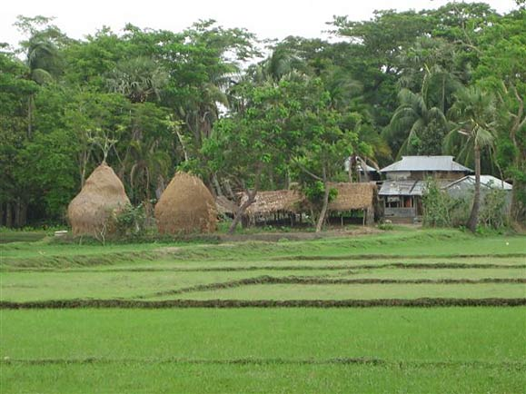
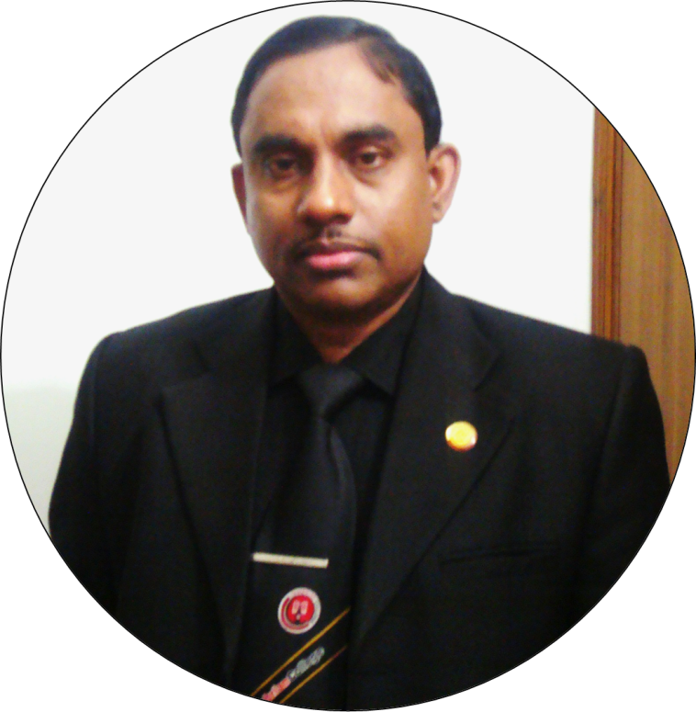
. Welcome to the world of HHR PowerPoint Presentation
Notes:
I have made it myself. Teacher may change it according to his will.

Slide 3
Introduction
Md. Hasan Hafizur Rahman
Lecturer & Head of the Department (English)
Cambrian School & College
Building -5, Dhaka.
Cell : 01717220115/01556652300
E-mail: hasancambrian@gmail.com
English For Today
Class- IX - X
Notes:
Introduction.

Slide 4
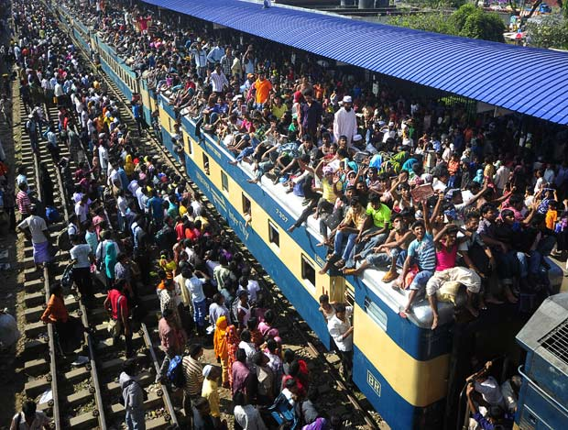
Watch & observe
Where are they going?
Village home
Notes:
Teacher may go according to animation.

Slide 5
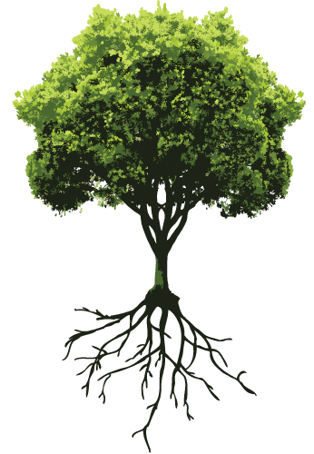
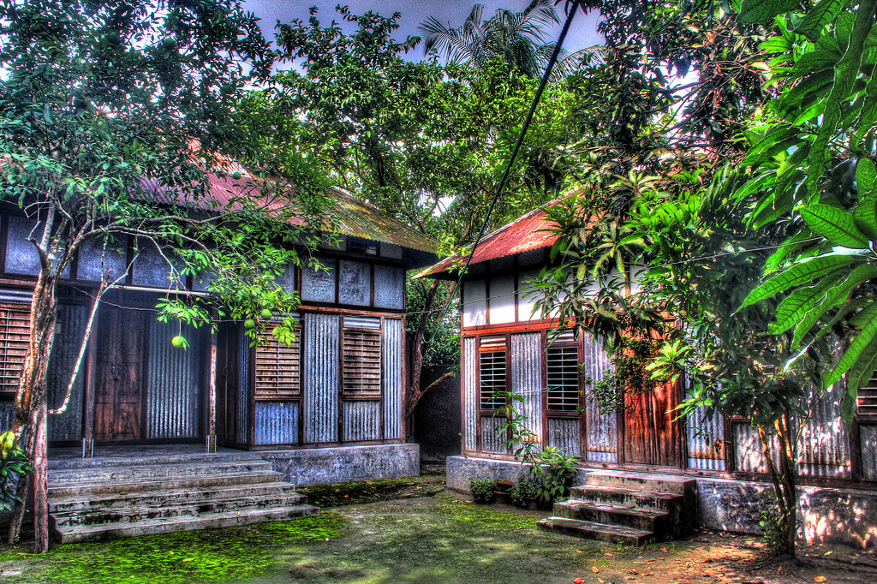
What do you mean?
Root
Birth place / Paternal address
Notes:
Inner significance of roots shown here.

Slide 6
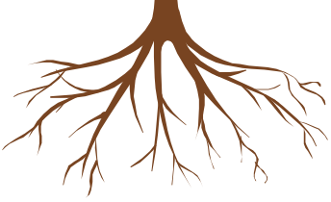
Our Today’s Lesson is--
My Root
Unit-12, Lesson-1
Notes:
Lesson declaration.

Slide 7
Learning outcomes
After we have studied this lesson, we will be able to—
ask and answer questions
narrate incidents and events in a logical sequence
present information in a chart
read and understand the text through silent reading
Notes:
All the four skills will be focused in this lesson.

Slide 8
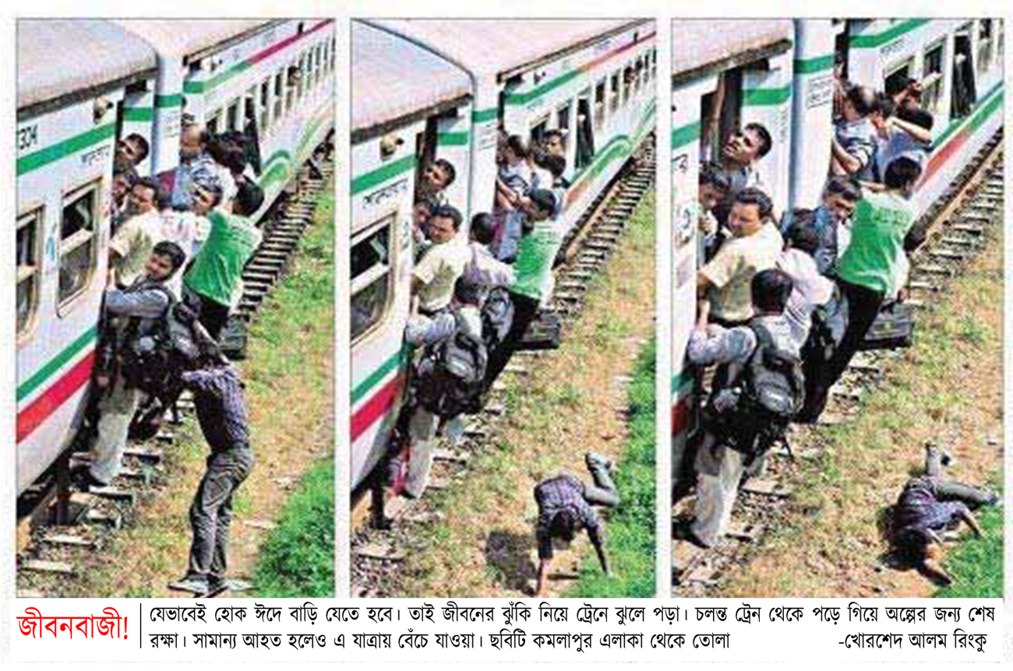
A Look at the pictures and the caption below. How do you feel to see this photo? Why do you think people take such risks to go home to celebrate their Eid?
Notes:
Text lesson begun. The circles are to highlight risks.

Slide 9
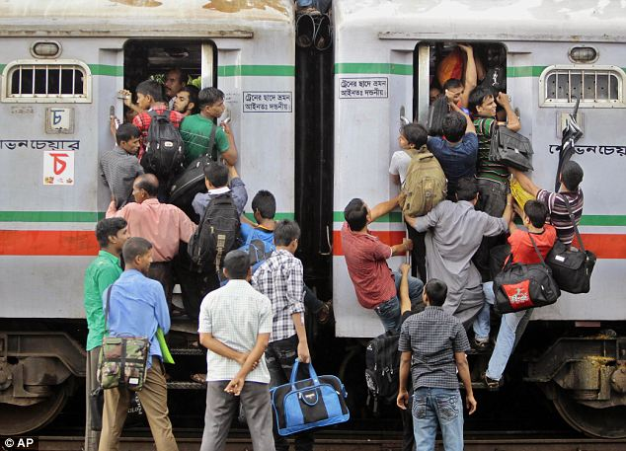
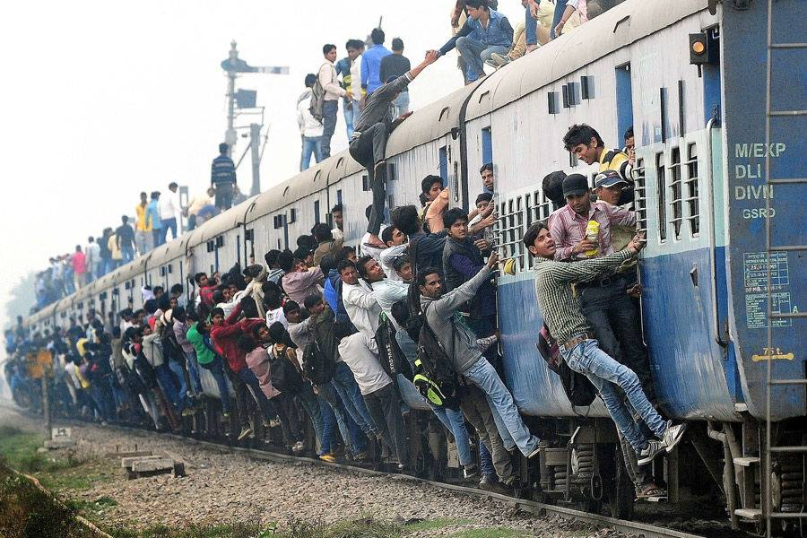
Going to village home is a must,
that may be at any cost.
Notes:
General scenario of Eid vacation.

Slide 10
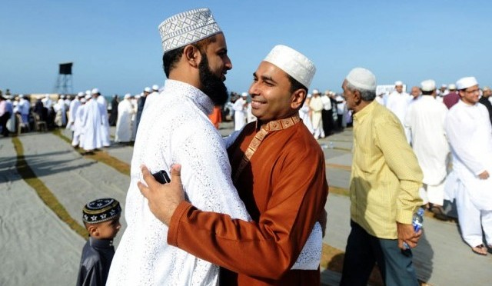
What is the picture about?
Eid
Notes:
Advanced to Eid definition. Teacher may go according to animation.

Slide 11
What is Eid?
Eid is the main religious festival of the Muslims in Bangladesh. Eid means happiness.
Notes:
Definition of Eid.

Slide 12
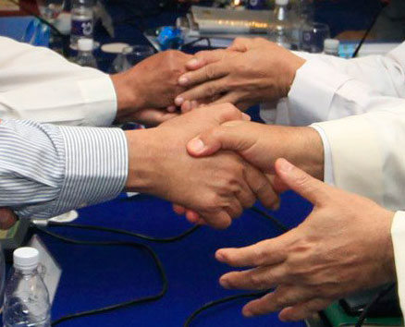
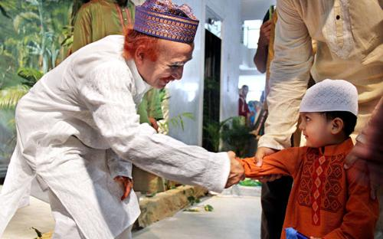
What does everyone want during Eid?
Everyone wants to share happiness with their near and dear ones during Eid.
Notes:
Text direction.

Slide 13
So what happens then?
So most of the people, who are living outside their home for different reasons have a strong desire to get back home during the Eid vacations.
Notes:
This is placed with question to make the subject matter clear to the learners.

Slide 14
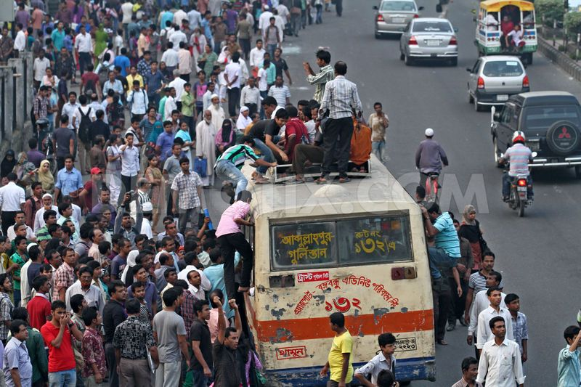
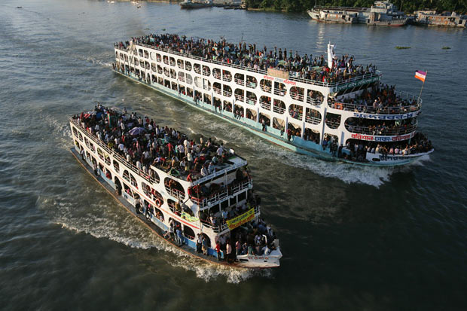
As a result, there is a mad rush in the--
buses
trains
or launches for the home-bound people.
Notes:
Text shown by showing images.

Slide 15
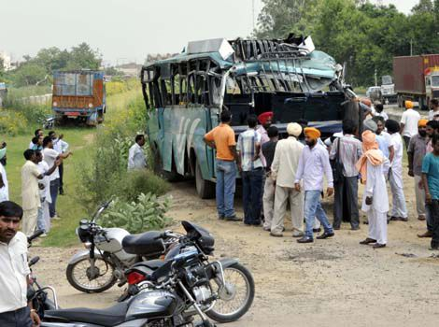
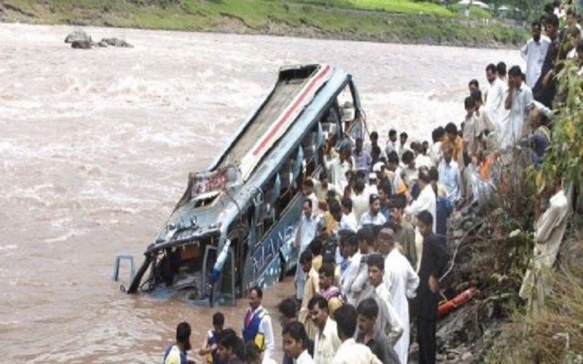
What is caused afterwards?
Accident.
Notes:
Though it is undesirable, it very practical.

Slide 16
Can it stop people's desire to meet their family, , or friends?
in-laws
শ্বশুর বাড়ির আত্মীয়
‘No’
Notes:
Blue coloured words are triggered. Please click ‘in-law’ to show the meaning. I did not find any word but Bengali to make the meaning ‘in-law’ clear. If you have any word in English to make the meaning clear more, it is better.

Slide 17
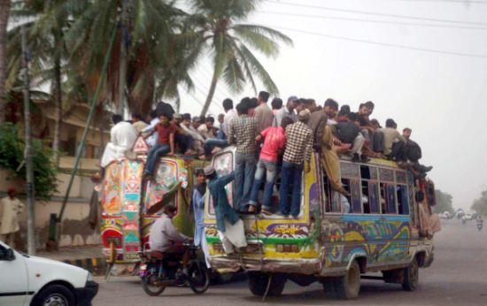
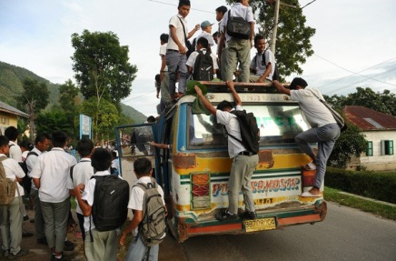
What makes people for their homes in spite of serious ?
rush
hazards
Notes:
‘rush & hazards’ are triggered. Please click the blue coloured words to show the meanings of the two words.

Slide 18
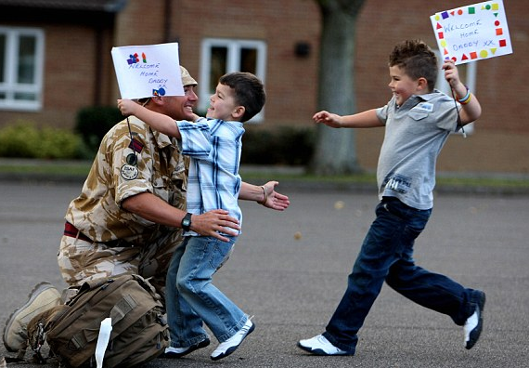
This is the pull of the roots.
Notes:
Invisible connection is shown here to clear human pull.

Slide 19
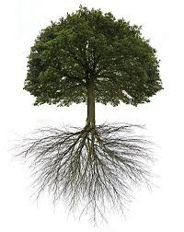
Do human beings have-
roots like the trees?
Notes:
Human beings have roots but not visible like the trees.

Slide 20
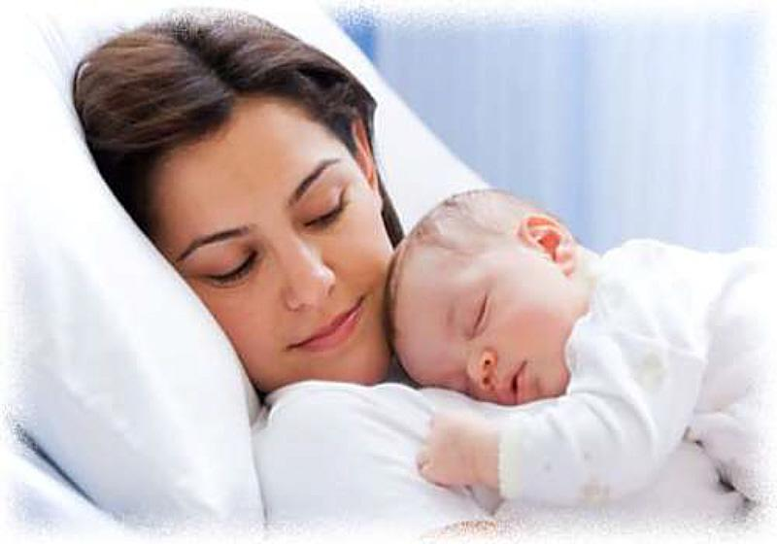
Yes
The answer is-
but unlike the roots of the trees they are invisible, they lie in our minds.
Notes:
Human beings have invisible roots. The picture is the sign of it.

Slide 21
Notes for the teachers not for the students
Dear colleagues,
Digital content showing may be ended with the slide number 20. You may conduct the rest of the class manually just with the text book, board, marker and paper (Khata).
Notes:
Teacher may stop digital presentation from slide No. 20.

Slide 22
Dear leaners,
Let us have a tour from the text directly to know the rest about roots.
Open your text book at page 141 and start reading from “It’s these roots that make a bond between………………..feel empty and lost silently. I am always be with you.
Notes:
Reading skill will be focused in this option. Teacher may move in the classroom to help the students reading the lesson.

Slide 23
B Read the following text.
It's these roots that make a bond between us and family members, in­-laws, friends, neighbours or even between us and the land where we were born and grew up. In that sense our families, land of birth, relatives, our culture, traditions, or surroundings are our roots. And wherever we stay, we have a continuous pull of our roots. It's our roots that develop our identity making us what we are. When we lose that bond, we become rootless. Human beings who do not have any root or contexts, are non entity. In other words, they do not have their own identity. Such persons are devoid of values, humanity, and social responsibilities. They don't know where they are from, and/or where they are heading towards. This often makes them feel empty and lost.
Notes:
This may be helpful to the students those who have no books with them. Actually Text like this slide is not allowed in a digital presentation.

Slide 24
C Read the text in the speech bubbles. Make questions for them and then compare in pairs.
Eid is the main
religious festival of
the Muslims in
Bangladeh.
Eid means happiness.
In that sense our families, land of birth, relatives, our culture, traditions, or surroundings are our
roots.
It’s our root
that develops our
identity making s
what we are.
Notes:
Evaluation option from the text.

Slide 25
D Fill in the grid with appropriate information from the text above.
That makes our roots | The problems of a rootless person
1................................ 2................................ 3................................ 4................................ 5................................ | 1………………………… 2………………………… 3………………………… 4………………………… 5…………………………
Notes:
Evaluation.

Slide 26
E Work in pairs. Talk about these questions.
Do you have any root other than the place where you are living now? If yes, where is it and who are there?
If not, why not?
2. How do you label your roots?
My roots belong to
an extreme rural village a village
a semi-urban area (upozila) a small town
a moderate city a suburb
a city
3 Do you feel any attraction or pull of your roots?
4 How do you nourish your roots?
5 What, according to you, are the reasons why people become rootless?
F Make a classroom survey and present in a chart the types of roots your classmates have.
Notes:
Learners are supposed to do pair work in section E and Group work in section F.

Slide 27
Thank you dear ones
Notes:
Ending slide.

